Slide 1
Yelp 2.0
Marco Gancitano, Asna Ali, Hitesh Shetty

Slide 2
Table of Contents
Project Idea
Data Mining
Sources and Types of Data
Web Scraping Process
Topic Modeling and Polarity
Information Retrieval
User Interface/Testing

Slide 3
Project Idea
Improve Yelp’s restaurant rating system to give the consumer more detailed information
Create scores for implicitly reviewed aspects of the businesses
Hygiene, customer service, food quality, etc.
Allow for more relevant search results now that there’s a more detailed understanding of the business

Slide 4
Sources and Types of Data
Main source of data is directly from Yelp.com
Restaurant information
Overall rating, address, restaurant ID, etc.
User information
Name, # of reviews, user ID, etc.
Review information
Rating, description, restaurant ID, user ID, etc.

Slide 5
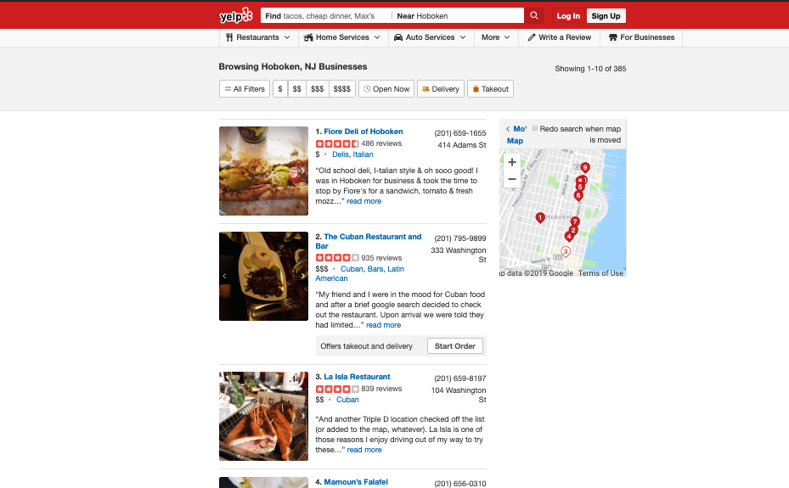
Web Scraping Process
Step 1: Getting all the restaurants in Hoboken

Slide 6
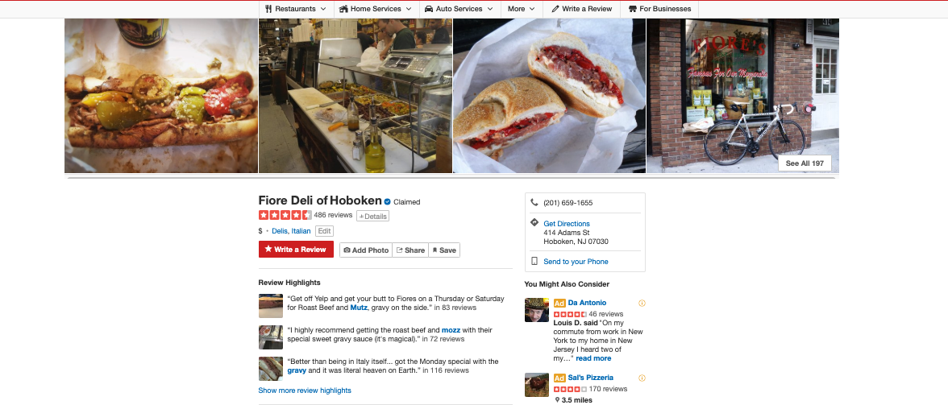
Web Scraping Process (cont.)
Step 2: Getting the restaurants’ information

Slide 7
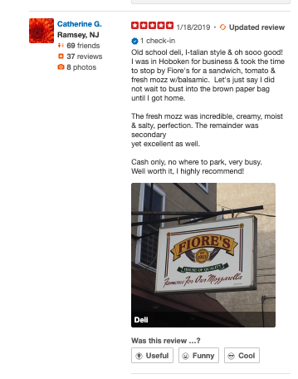
Web Scraping Process (cont.)
Step 3: Getting information on the reviews

Slide 8
Web Scraping Process (cont.)
Main Challenge
Getting pushed to a CAPTCHA page by Yelp
Solutions
Use a free proxy to try and mask my IP
Yelp knew of these free IPs and blocked any access from them.
Built a function which detected a CAPTCHA page, opened a selenium browser of it, and I manually finished the CAPTCHA.
Worked as our solution but slowed down scraping time

Slide 9
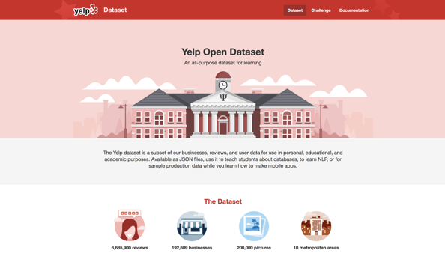
Training the Model

Slide 10
Testing the Model
“The best food the best place to eat chicken and waffles on a slow day. However this was my first time back to the deli since moving back to the area.”
sentiment("hello very nice day") # (0.78)
sentiment("very day nice hello") # (0.4)
sentiment("very hello very nice day") # (0.49)

Slide 11
LDA
Topics Associated to the Sentence
[(0, 0.06013425),
(1, 0.20457779),
(2, 0.30940828),
(3, 0.02120836),
(4, 0.143796033),
(5, 0.05160969),
(6, 0.01121853)]
Topics Associated to Words in the Sentence
[(0, [2]),
(1, [2, 3]),
(2, [1, 0, 3,]),
(3, [2, 0]),
(4, [1, 2]),
(5, [1, 5]),
(6, [2,4])
(7,[3]

Slide 12
[(1,[2,4,5]), (2,[0,1,3,6])]
﻿{'best': 0, 'food': 1, 'place': 2, 'eat': 3, 'chicken': 4, 'waffles': 5, 'slow': 6, 'day': 7}
['best', 'food', 'best', 'place', 'eat', 'chicken', 'waffles', 'slow', 'day']
“place chicken waffles”
0.1
“best food best eat slow”
0.5666666666666667
{0: [], 1: [0.1], 2: [﻿0.5666666666666667 ,0.27499999999999997, 0.0], 3: [], 4: [], 5: [], 6: []} ﻿
{‘Order Selection': 0.1, ‘Location’: 0.42}

Slide 13
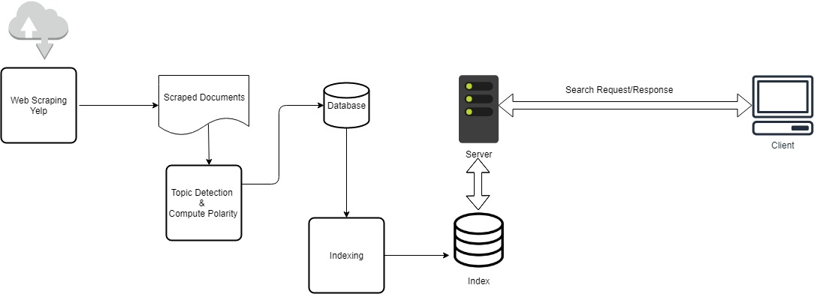
Information Retrieval
Architecture

Slide 14
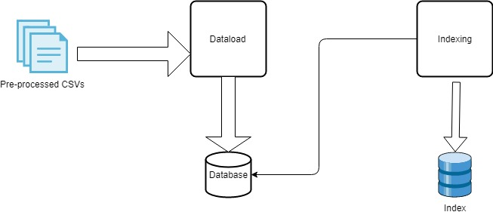
Information Retrieval(cont.)
Dataload & Indexing

Slide 15
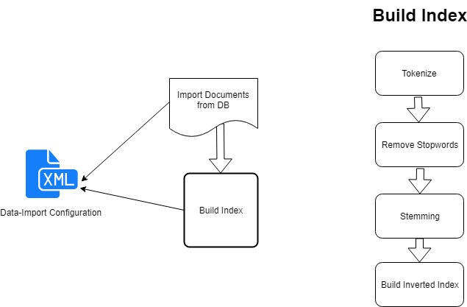
Information Retrieval(cont.)
Indexing

Slide 16
User Interface & Testing
Tech Stack
Django
Mustache.js
jQuery
Bootstrap 4.0
Features
Document Listing.
Topic Filters.
Pagination.
Average Topic Polarity Indicator.

Slide 17
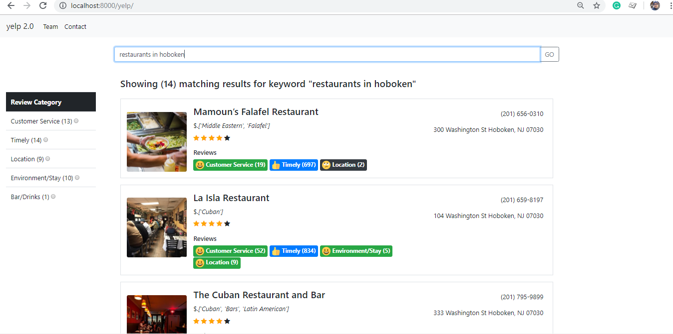
User Interface & Testing….
Search Results and Average Topic Polarity Indicator:

Slide 18
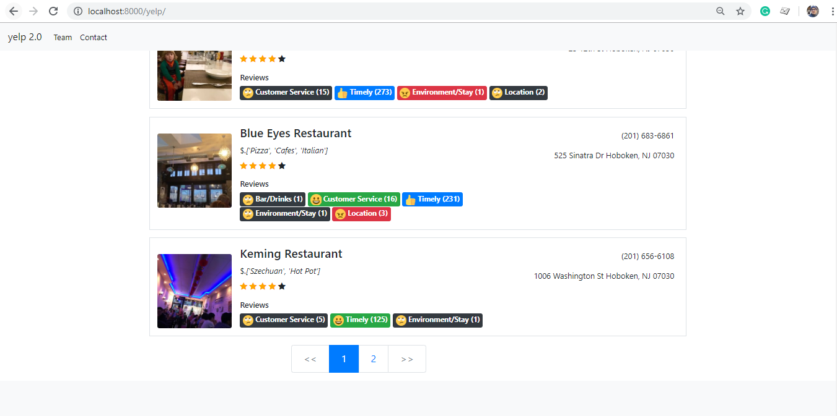
User Interface & Testing….
Pagination:

Slide 19
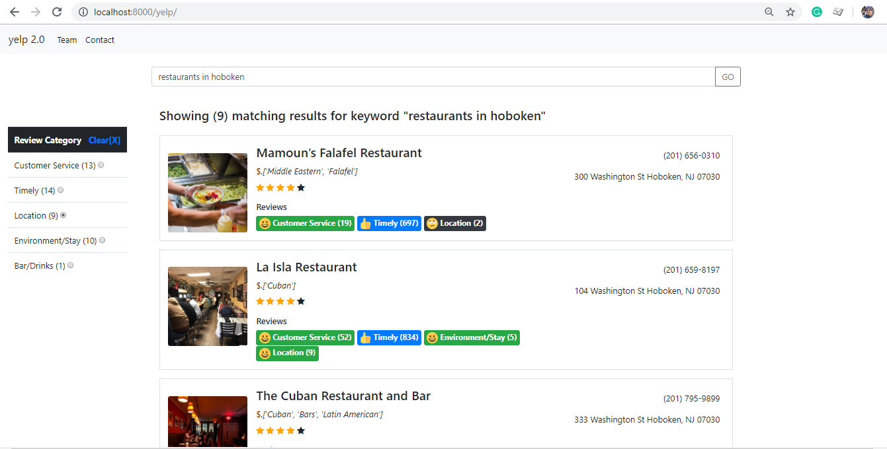
User Interface & Testing….
Topic Filters:

Slide 20
Thank You

